Slide 1
Heterogeneity, Subgroup analysis and meta-regression
Michail Belias
15/02/2019

Slide 2
What have we learned so far?
meta-analysis
We can combine a number of aggregated data, in order:
Observe the consistency of a treatment effect
To make more powerful inferences
To take decisions based on more evidence than a single trial can offer
Data could be pooled quantitatively if study designs are similar in:
outcome definition
population sizes
population characteristics
interventions

Slide 3
Types of meta-analysis
Fixed (or common) effect meta-analysis
The underline treatment effect is common for every study;
No heterogeneity
Can be use also as a summary of our data, without generalising
Random effects
True effect estimate for each study varies;
Heterogeneity
Produces larger CIs
Why?
Because it takes into account that our data come from a variety of treatment effects and not from one common effect

Slide 4
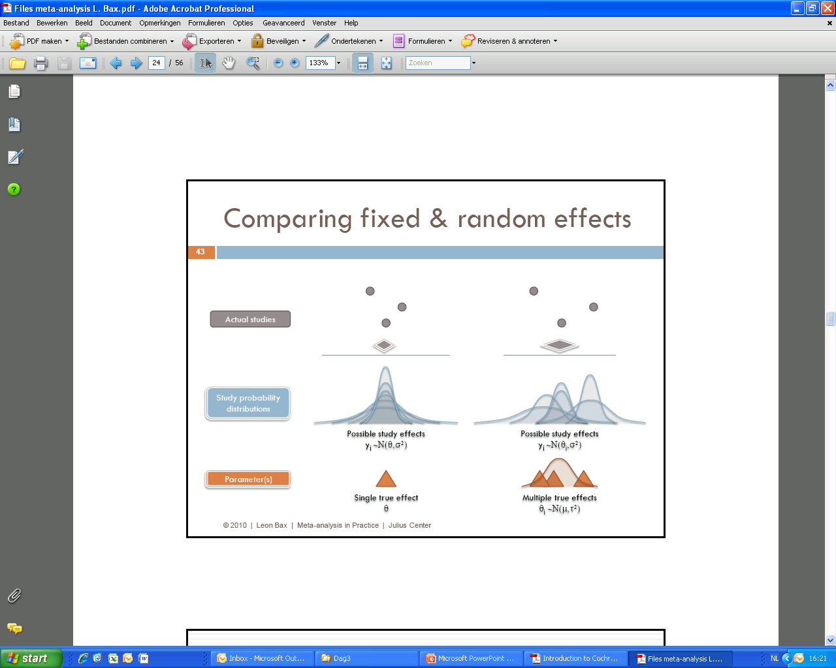
Two approaches: fixed / random effects
4

Slide 5
Heterogeneity
Heterogeneity: Greek word comes from Ετερος + γένος.
Means a set of things that are made of different structure and therefore they produce different results
Trials may vary due to either clinical or methodological reasons
Clinical heterogeneity
Variability in the participants
For instance in age, blood pressure, life style…
Variability in the interventions
Different countries (and health systems)
Methodological heterogeneity
variability in study design (RCTs, Observational, blinded, matched….)
Adjustment for confounders
Treatment dosages
Timepoints of outcome measurement (6 months vs 1 year)

Slide 6
Statistical heterogeneity
Clinical heterogeneity + Methodological heterogeneity
Statistical heterogeneity
Variability in the intervention effects being evaluated in the different studies. It is a consequence of clinical or methodological diversity, or both, among the studies.
This is what we are estimating in our analyses

Slide 7
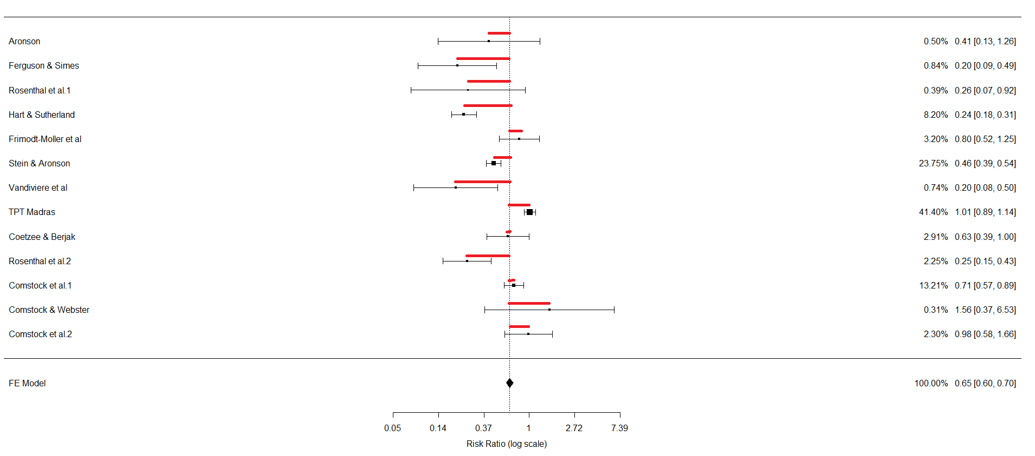
Estimate Heterogeneity
There are several measurements to estimate Heterogeneity
Most based on the variance of the estimates ( Cochran’s Q)
Cochran’s Q is the weighted mean square distance of all effect estimates from the pooled. (variance of the estimates)

Slide 8
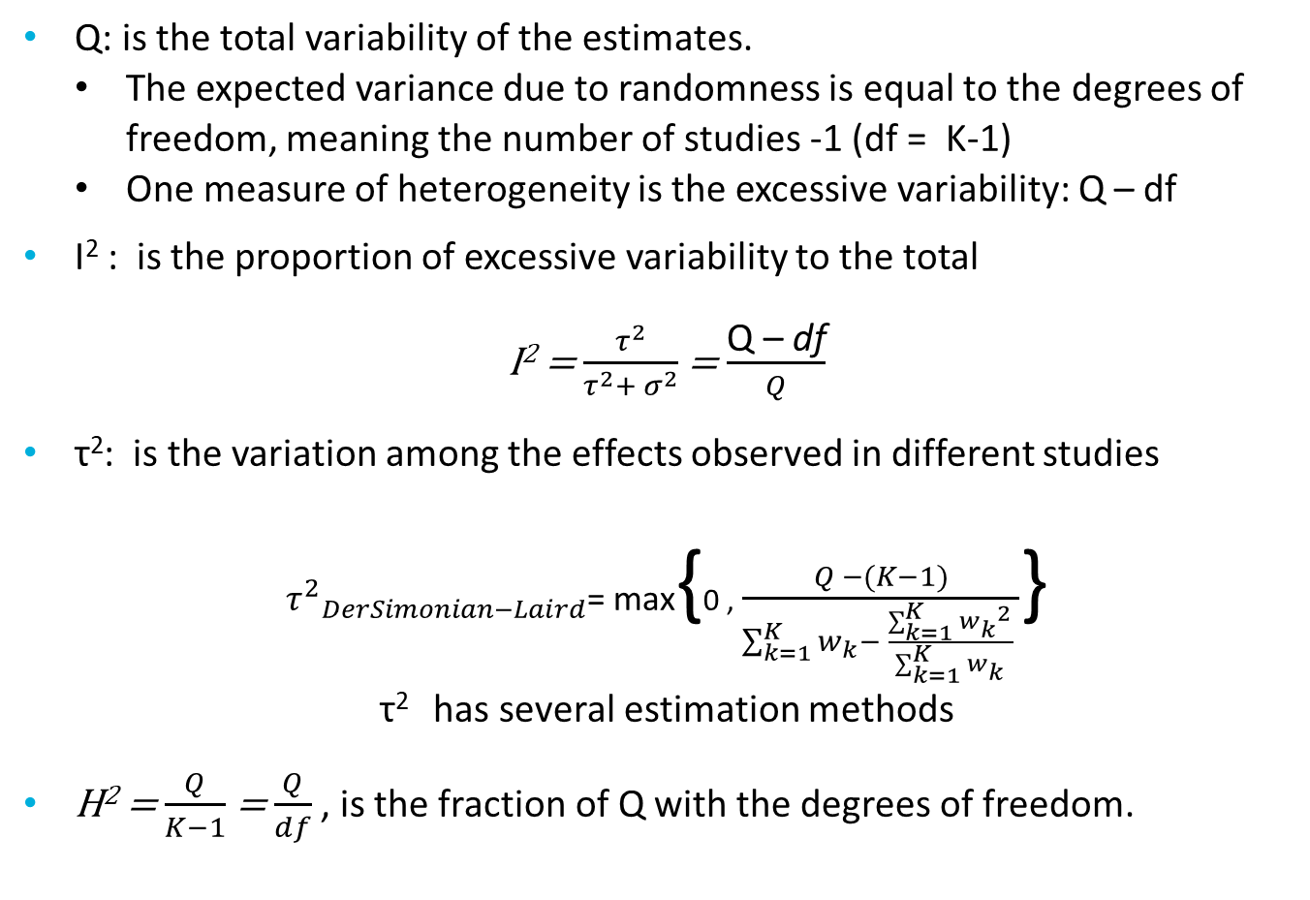
Estimate heterogeneity
Q: is the total variability of the estimates.
The expected variance due to randomness is equal to the degrees of freedom, meaning the number of studies -1 (df = K-1)
One measure of heterogeneity is the excessive variability: Q – df
I² : is the proportion of excessive variability to the total
I² = $\frac{τ^{2}}{τ^{2}+ σ^{2}}$ = $\frac{\text{Q}\text{ – }\text{d}\text{f}}{Q}$
τ²: is the variation among the effects observed in different studies
${τ^{2}}_{DerSimonian−Laird}$= max{0 , $\frac{Q −(K−1)}{\sum_{k=1}^{K}{w_{k}}− \frac{\sum_{k=1}^{K}{{w_{k}}^{2}}}{\sum_{k=1}^{K}{w_{k}}} }$}
τ² has several estimation methods
H² = $\frac{Q}{K−1}$ = $\frac{Q}{df}$ , is the fraction of Q with the degrees of freedom.

Slide 9
Explore heterogeneity
One task is to estimate a pooled treatment effect and take into account it’s heterogeneity
Another is to find out where does this heterogeneity come from
There two main methods to achieve that
Subgroup analysis
Meta-regression
Both use study level characteristics
If we have patient level characteristics then we should do an IPD-MA
How?

Slide 10
Subgroup analysis
If we believe that we can explain part of the heterogeneity with a categorical variable, then we can perform subgroup analysis.
In subgroup analysis we split our data over the k levels of the categorical variable
We perform k number of meta-analyses
Then we can compare the results per subgroup and calculate the amount of variability we explained by this procedure.

Slide 11
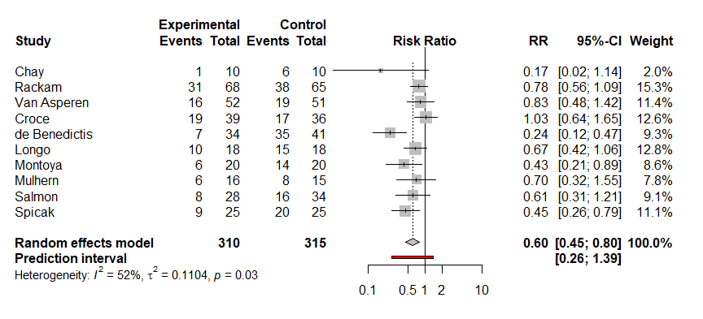
Subgroup analysis example
The effect of Ketotifen in the use of rescue bronchodilators Ketotifen has been investigated.
10 trials have been analysed
3 were blinded, 7 unclear

Slide 12
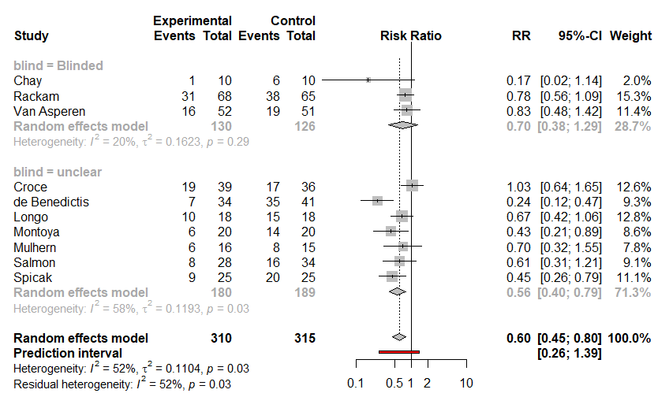
Subgroup analysis example

Slide 13
Linear regression
Let’s first refresh linear regression.
When we have a continuous outcome Y_{i}
The standard linear regression model is given by:
Y_{i} = β₀ + β₁x_{i1} + β₂x_{i2} +…+ β_{p}x_{ip} + ε_{i} ,where ε_{i}∼N(0,σ²).
To make things simpler lets assume that we have only one independent variable x1 , then
Y_{i} = β₀ + β₁x_{i1} + ε_{i}
We can use our effect estimates (logOR, logRR, MD, SMD…) as Y_{i} and fit a linear regression
If the x₁ is categorical the analysis is called subgroup analysis (with common τ²)
If the x₁ is continuous the analysis is called meta-regression

Slide 14
Meta-regression
Meta-regression:
In this approach we relate size of effect to continuous characteristics of the trials
Some examples
The latitude of the country the trial was performed
The mean age of the participants
The mean blood pressure of the participants per trial
The year of publication
Note: we use aggregated data
The continuous variable is calculated on trial level

Slide 15
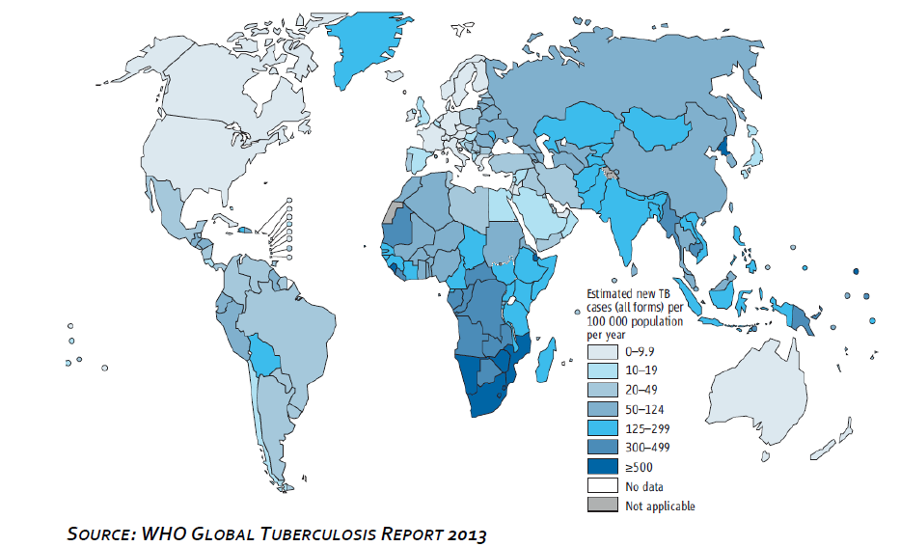
Tuberculosis 2012
Notes:
Six year later, in 1921, Professor Arvid Wallgren started the development of intradermal administration of BCG (6)
Despite nearly a century of use, BCG remains controversial and causes a lot of debate among the scientific community worldwide, mainly related to the efficacy of the vaccine. While there is little doubt about BCG high efficacy shown in many studies conducted in Scandinavia (7-10), the United States (11-12), Great Britain (13) and Canada (14), wherein discrepancies between regions were observed even if a protective effect against severe disseminated forms of TB in children was shown.
The discrepancies of BCG efficacy have triggered queries for the need of new vaccines (15), since revaccination with BCG did not offer additional benefit in term of efficacy.

Slide 16
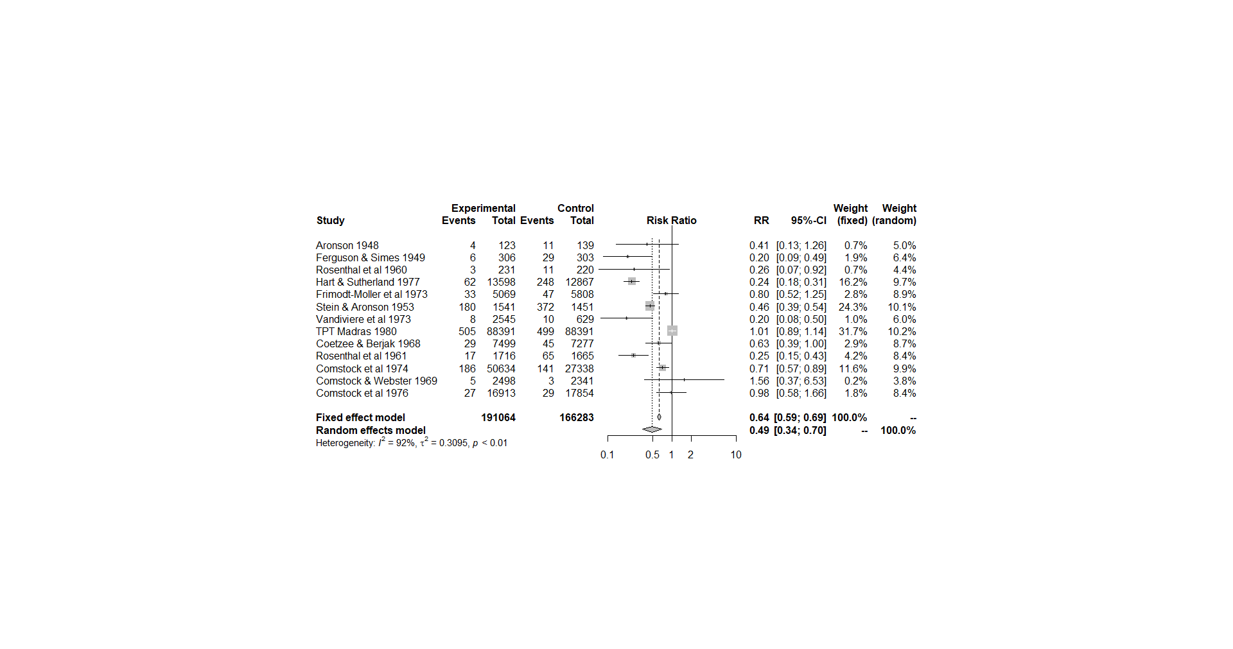
Meta-regression example

Slide 17
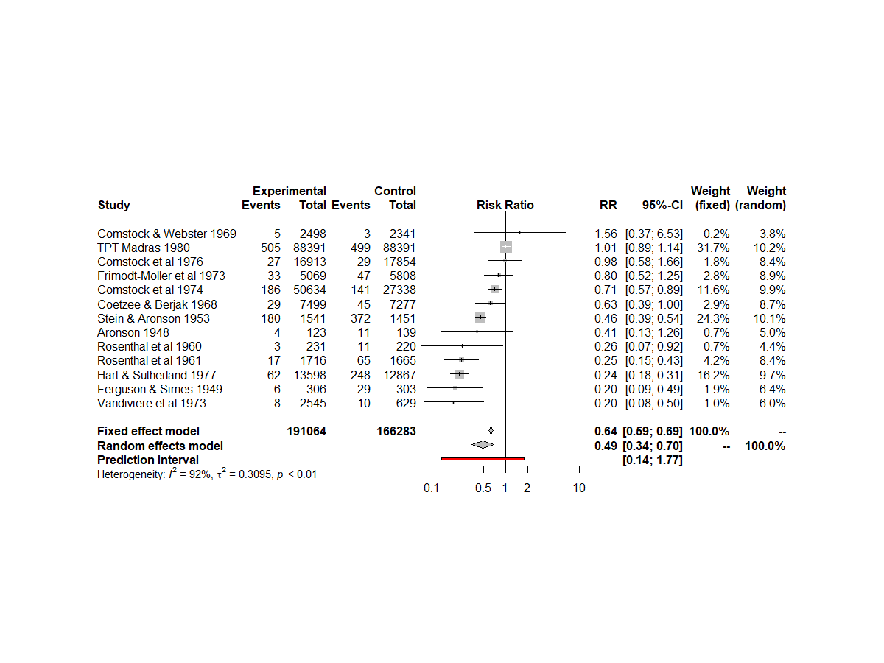
Tuberculosis data-set ordered by RR size

Slide 18
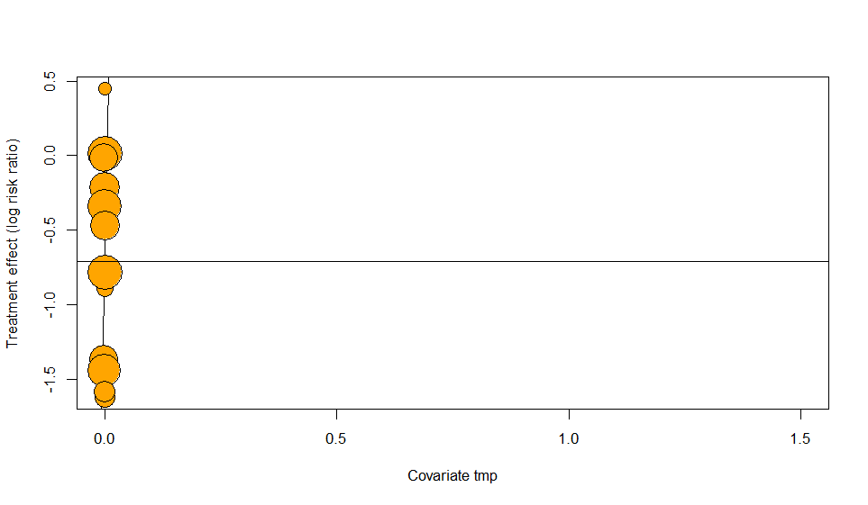
Bubble plot BCG effect on tuberculosis prevalence
Log (RR)
logRR=0 : No effect
Mean logRR =-0.72
RR = 0.49
Strong beneficial effect
I² = 92.1%, tau = 0.56
Notes:
Till now we showed tthe results in forest plots, but in meta-regression, often the bubble plot is used. Here you see the same results of the previous forest plot but now in bubble plot.
Bubble plot. Each study bubble, the larger the study weight in the meta-analysis, the larger the bubble.
Vertical you see the effect of vaccination

Slide 19
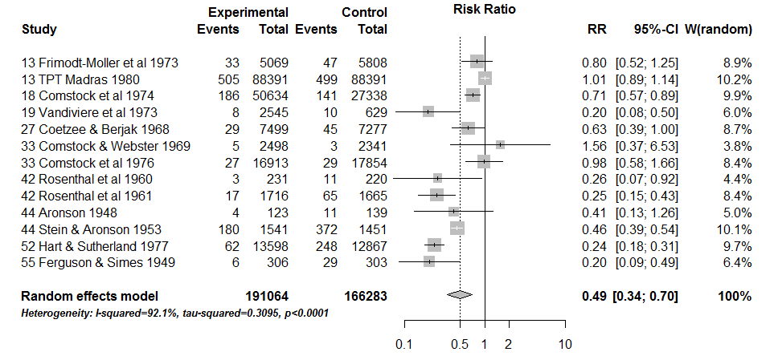
BCG effect, studies sorted by latitude
BCG effect seems stronger with higher latitude
Notes:
Omdat het leek of de resultaten afhankelijk van lokatie waren, en dan mn distance to equator, (latitude), zie je hier een forest plot gesorteerd op latitude
Here you see indeed that the further away from the equator, the larger the effect.

Slide 20
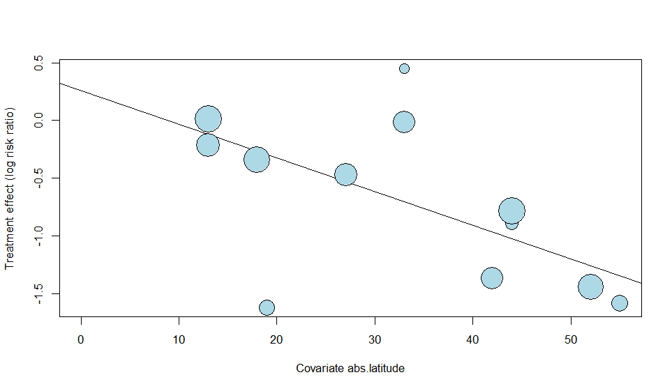

BCG effect by latitude
Log (RR)
After meta-regression: I² = 64.2%, tau = 0.25
Before: I² = 92.1%, tau = 0.56
Absolute Latitude
Notes:
After meta-regresssion Less variation , because less distance to estimated summary line

Slide 21
BCG effect by latitude
Meta-regression results (from R)
estimate se zval pval ci.lb ci.ub
Intercept 0.26 0.23 1.12 0.26 -0.20 0.71
abs.latitude -0.03 0.01 -4.34 <.01 -0.04 -0.02
The regression coefficient (-0.03) describes how the outcome variable (the BCG effect, as logRR) changes with a 1 unit increase in the explanatory variable (the latitude)
Formula: Estimated Log RR = 0.26 - 0.03 x absolute latitude

Slide 22
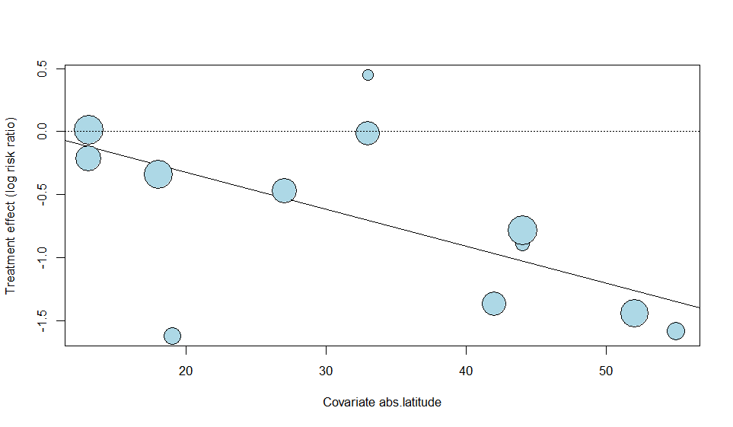
BCG effect on tuberculosis in Nijmegen
estimate se
intercept 0.26 0.23
abs.latitude -0.03 0.01
Latitude Nijmegen : 51.9 degrees
Estimated log RR in Nijmegen: 0.26 - 0.03 x 51.9 = -1.297
Estimated RR in Nijmegen: exp(-1.297) = 0.275
Nijmegen

Slide 23

BCG effect at equator???
Intercept=0.26, RR = 1.3
RR=0.6
RR=0.37
RR=0.22
Nijmegen
What do you thing?
intercept = 0.26 → at equator RR = exp(0.26) = 1.3: Harmful!
Very unreliable and improbable: extrapolation way beyond available data!
Notes:
Rode circel: extrapolation way beyond available data, must be incorrect, would mean that at equator the BCG vaccination causes tuberculosis
Nijmegen ~ 52
This can be prevented if you first center your covariate, so that the intercept will be the mean value of the covariate, e.g. 33.5, or a prespecified value of interest, e.g. 30 degrees.

Slide 24
Short breath
In both Subgroup analysis and meta-regression we used study level characteristics

Slide 25
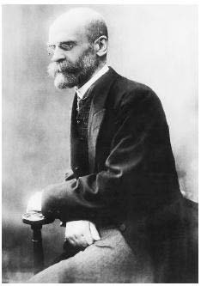
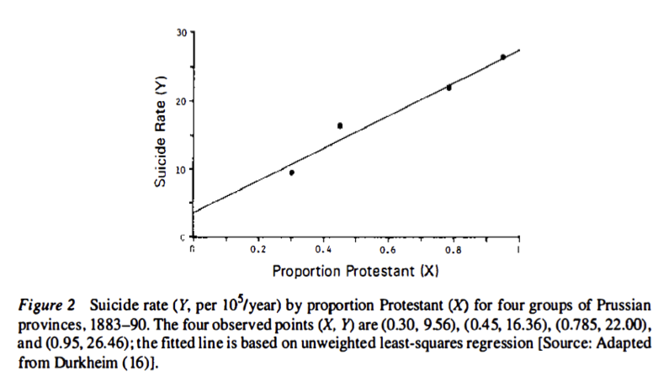
Suicide rate by proportion Protestant (Durkheim, 1897)
Notes:
According to Morgenstern, the estimated rate ratio of 7.6 was probably not because suicide rates were nearly 8 fold higher in Protestants than in non-Protestants.
Rather, because none of the regions was entirely Protestant or non-Protestant, it may have been non-Protestants (primarily Catholics) who were committing suicide in predominantly Protestant provinces. It is plausible that members of a religious minority might have been more likely to commit suicide than were members of the majority. Living in a predominantly Protestant area had a contextual effect on suicide risk among Catholics.
https://www.causeweb.org/wiki/chance/index.php/Chance_News_92

Slide 26

Ecological fallacy
Studying a phenomenon with a group (e.g. “study”) as unit of analysis
But making inferences on the individual persons

Slide 27
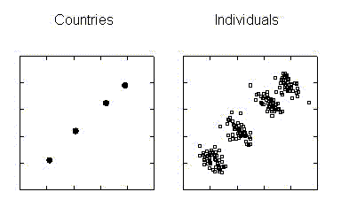
Food consumption vs. cancer risk?
Countries
Individuals
Plot 1: overall cancer risk per country, against per capita daily caloric intake (x-axis) Plot 2:
It could be that within countries those who eat more are less likely to develop cancer.
On the country level, per capita food intake may just be an indicator of overall wealth and industrialization.
Daily caloric intake
Notes:
The display shows cancer increasing with food consumption. But it is people, not countries, who get cancer. It could very well be that within countries those who eat more are less likely to develop cancer. On the country level, per capita food intake may just be an indicator of overall wealth and industrialization.

